Slide 1
Unmanned Ground Vehicle (UGV)
Muhammad Nazhan Bin Ramli
1816847

Slide 2
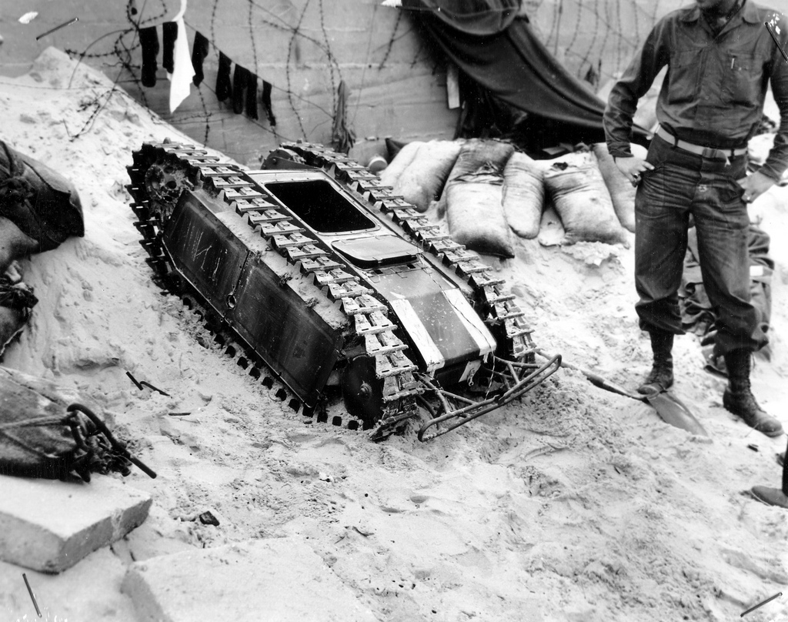
History of UGV
The first military UGV was probably the Russian TT-26 “Teletank,” which the Red Army developed in the 1930s. Two battalions of the Teletanks, which could be controlled remotely from another tank almost a mile away, were deployed in the Winter War against Finland in 1940. The teletanks could be mounted with machine guns, flamethrowers, and bombs. Closely thereafter, the German army unveiled the Goliath, a French-designed remote-control mini-tank that could be driven towards targets and remotely detonated. Despite their humble capabilities and their tendency to break, 7,564 Goliaths were produced. The Second World War saw the development of a number of similar single-use weapons platforms. Though it is tempting to define these as UGVs, the fact that they served exclusively single use bombs, rather than weapons delivery systems, means that they were more like precision-guided munitions than unmanned ground vehicles. A parallel would be to call a Hellfire missile a drone, rather than the Predator or Reaper that fires the missile and then returns to base to prepare for another mission.

Slide 3
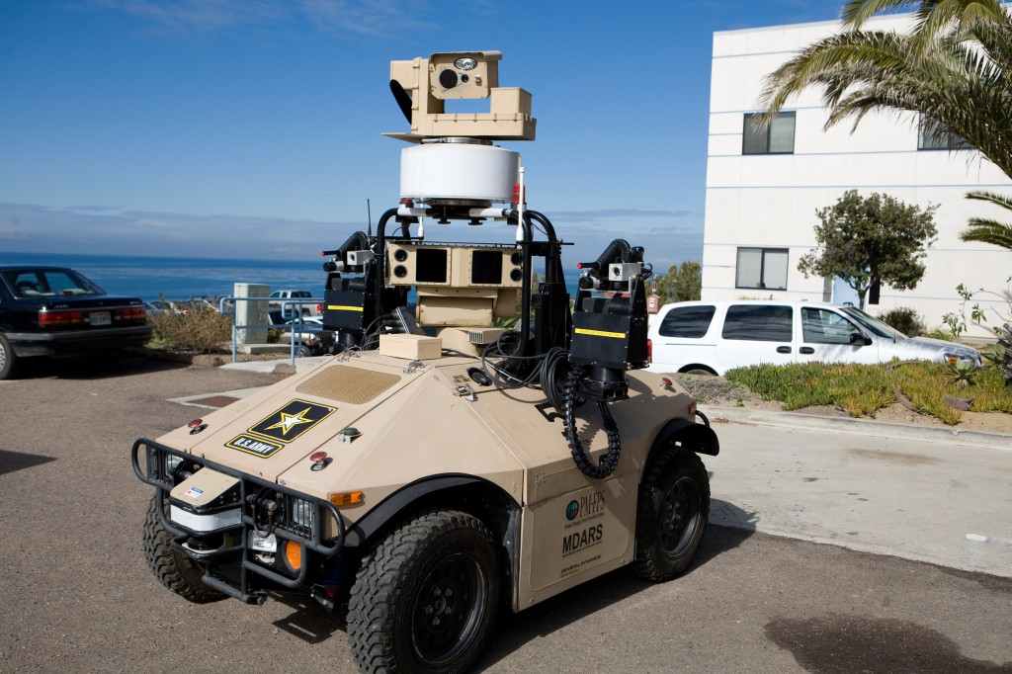
Currently, the U.S. and other advanced militaries deploy a whole ecosystem of unmanned ground vehicles, from Recon Robotics’ 1.2 pound Throwbot, which can be tossed into difficult-to-reach or dangerous spaces, to the a variety of large EOD robots, such as iRobot’s Warrior, which is strong enough to lift 400 pounds.
The basic unifying purpose of remote-control UGVs, even those like the Goliath that were technically not what we’d call a UGV, was to develop systems with complex and high-level capabilities–things like defusing bombs–without putting those human being who were traditionally used for these capabilities in harm’s way. The basic concept was to create a machine that was able to parallel human actions like peeking around corners so that a live human being didn’t have to. This paradigm is about to change as a new breed of UGVs emerge. Here’s a selection of what kinds of platforms we can expect in the immediate future.

Slide 4
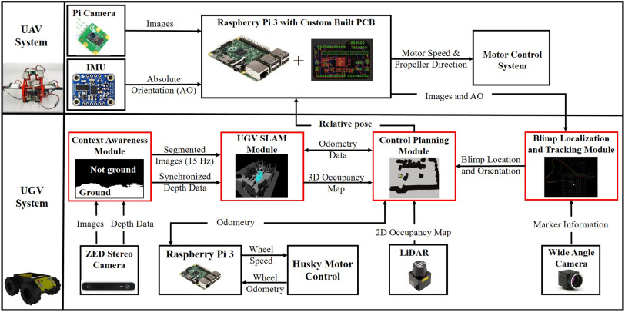
Basic System Architecture

Slide 5
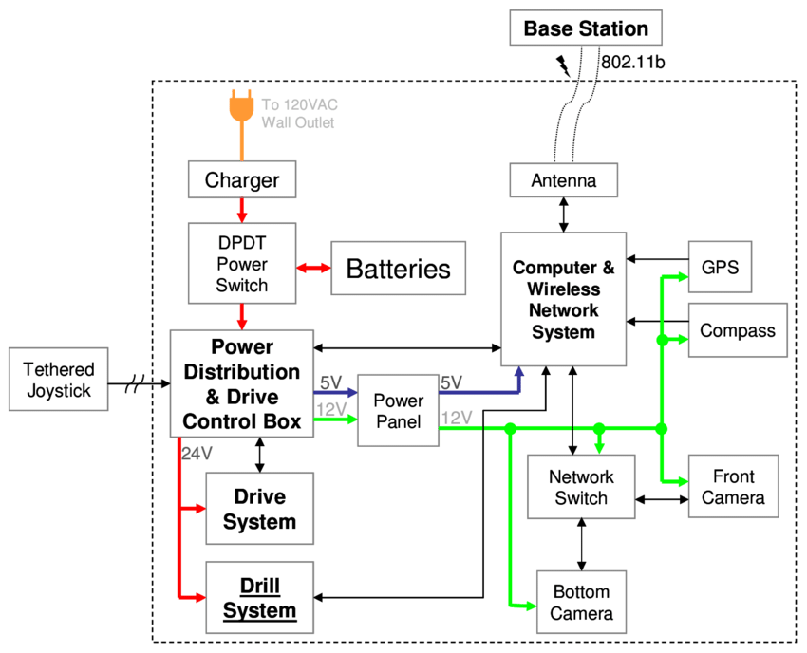

Slide 6
ROBOT DESIGN VS TASKS

Slide 7
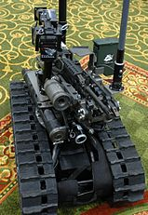
1) Military UGV
Foster-Miller claims the TALON is one of the fastest robots in production, one that can travel through sand, water, and snow, as well as climb the stairs. The TALON transmits in color, black and white, infrared, and/or night vision to its operator, who may be up to 1,000 m away. It can run off lithium-ion batteries for a maximum of seven days on standby independently before needing recharging. It has an 8.5 hour battery life at normal operating speeds, two standard lead batteries providing two hours each, and one optional lithium ion providing an additional 4.57 hours. It can withstand repeated decontamination, allowing it to work for long periods of time in contaminated areas. It was used at Ground Zero after the September 11 attacks, working for 45 days with many decontaminations without electronic failure. This led to the further development of the HAZMAT TALON.
The Talon has been deployed in military service since 2000 - for example, in Bosnia for the movement of munitions and EOD (explosive ordnance disposal) to dispose of grenades. It was also used at Ground Zero after the September 11th attacks in search and recovery. It is the only robot used in this effort that did not require any major repair.[Foster-Miller claims the Talon was used for a classified mission by US Special Forces in the war against the Taliban in Afghanistan, as well as in an EOD role. In Iraq its standard role has been performing EOD and IED destruction missions. Its combat SWORDS version is now being used there as a guard protecting front line buildings from attack. According to Foster-Miller, the robot has performed around 20,000 EOD missions in the conflicts in Iraq and Afghanistan.

Slide 8
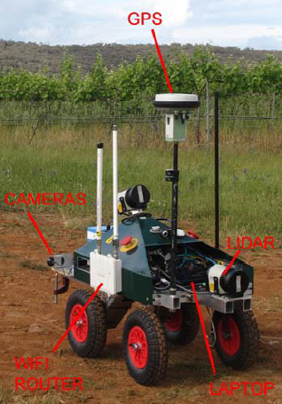
2) Agriculture Robot
The UGV was developed in the School of Mechanical and Manufacturing Engineering at the University of New South Wales under the direction of Associate Professor Jayantha Katupitiya and Dr Jose Guivant. As shown in Figure 4, it is a four wheeled vehicle equipped with sensors and actuators for teleoperation and full autonomous control. Weighing 50kg, it is a comprised of Commercial-Off-the-Shelf (COTS) sensors, a custom-made mechanical base and a low-cost onboard laptop with a wireless connection to a remote Base Station (BS). Of particular note is ready retrofitting capacity of the COTS sensors to existing farm machinery.

Slide 9
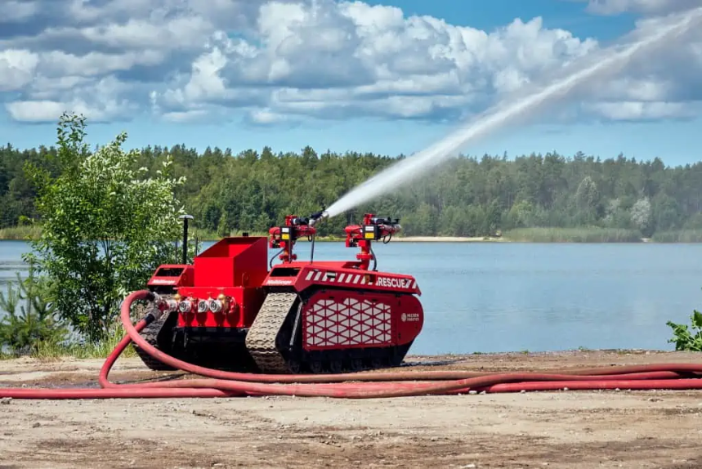
3) Firefighting UGV
Milrem Robotics and foam extinguishing technology specialist InnoVfoam have introduced the Multiscope Rescue Hydra, a UGV (unmanned ground vehicle) designed to provide firefighting capabilities. The jointly-developed solution combines Milrem Robotics’ Multiscope Rescue robotic vehicle with InnoVfoam’s .Hydra fire monitor and foam proportioning system.
The firefighting UGV can be remotely operated by firefighters who remain at a safe distance while receiving a complete overview of the operation area via thermal and infrared cameras, as well as onboard sensors that can detect gas or chemical leaks. The vehicle can also be used to deliver heavy firehoses, and to reach areas and enter structures that are inaccessible with bigger vehicles or that may collapse on top of firefighters. The vehicle can also be airdropped to forest or landscape fire locations to help limit the spread.

Slide 10
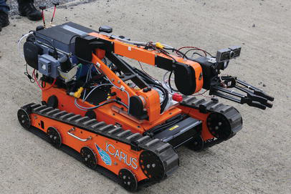
4) Urban Search and Rescue UGV
The LUGV was originally a commercial vehicle built by the French company Metalliance. It was adapted to the purposes of ICARUS project and provided to the University of Kaiserslautern. The main power is provided by a diesel engine which in turn actuates a hydraulic pump. This latter pumps oil into the pistons that actuate the two tracks. A turbine attached to a generator is actuated by the oil flow as well and this latter provides 220 V AC.

Slide 11
ACTUATORS & LOCOMOTIONS

Slide 12
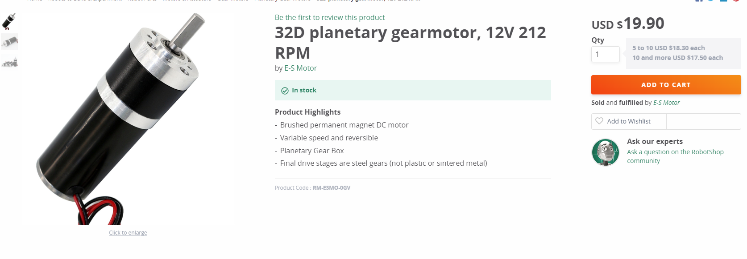
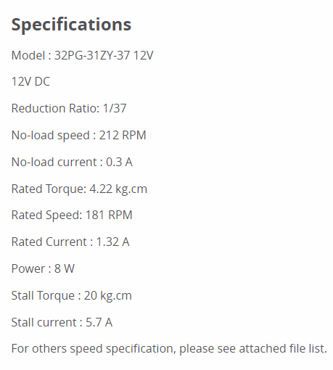
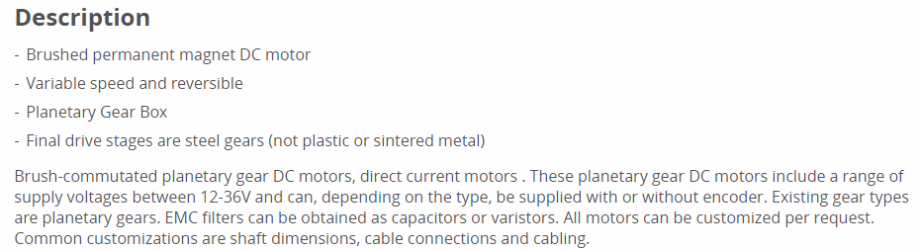
1) DC Motor

Slide 13
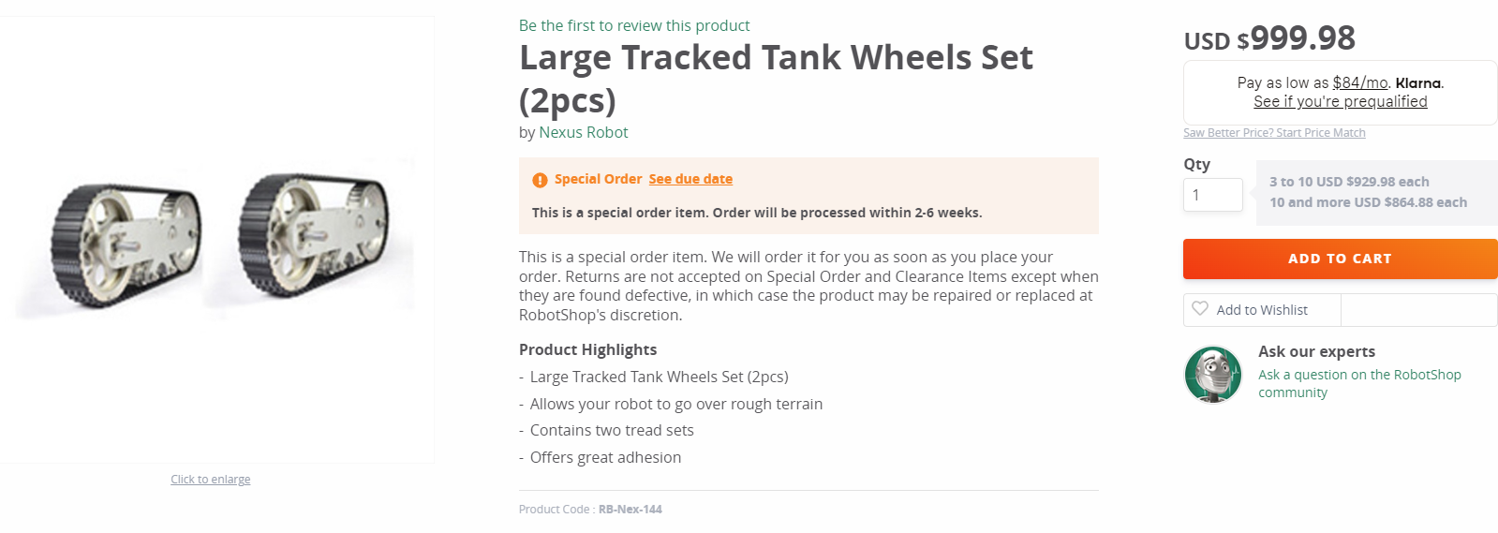
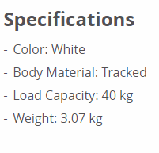
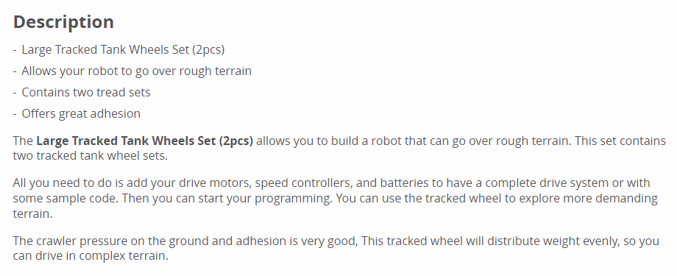
2) Tank Wheel

Slide 14
NAVIGATION SYSTEM & CONTROLLER

Slide 15
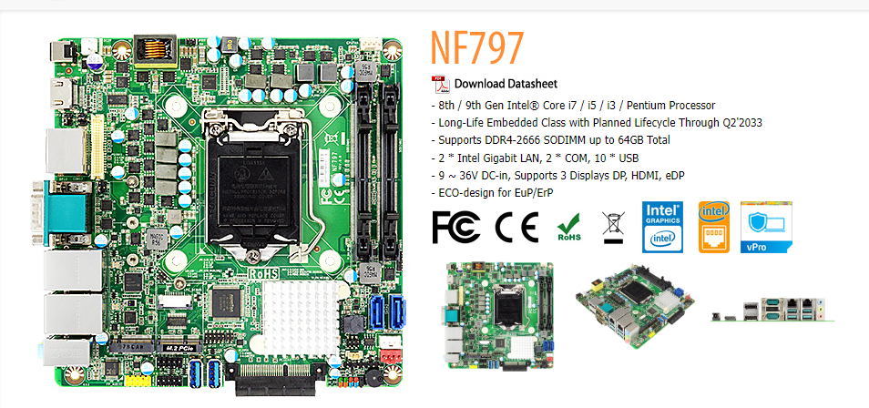
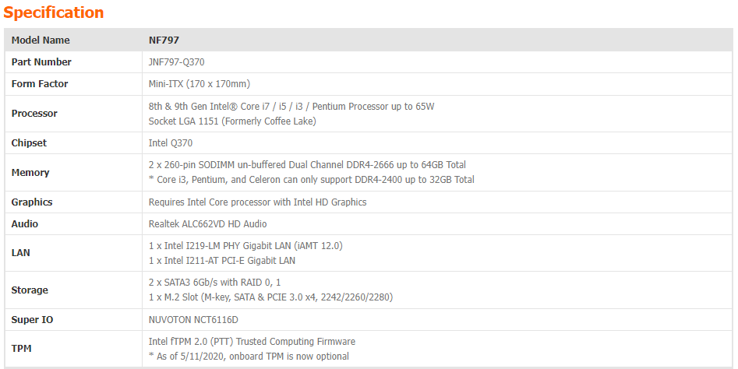
1) Controller

Slide 16
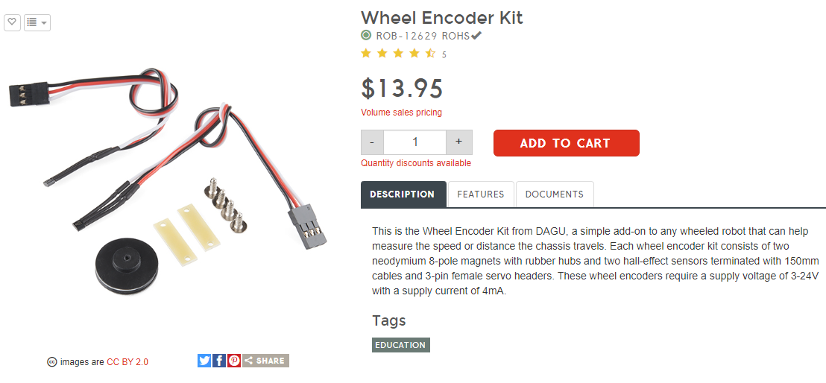
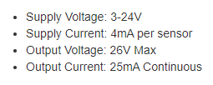
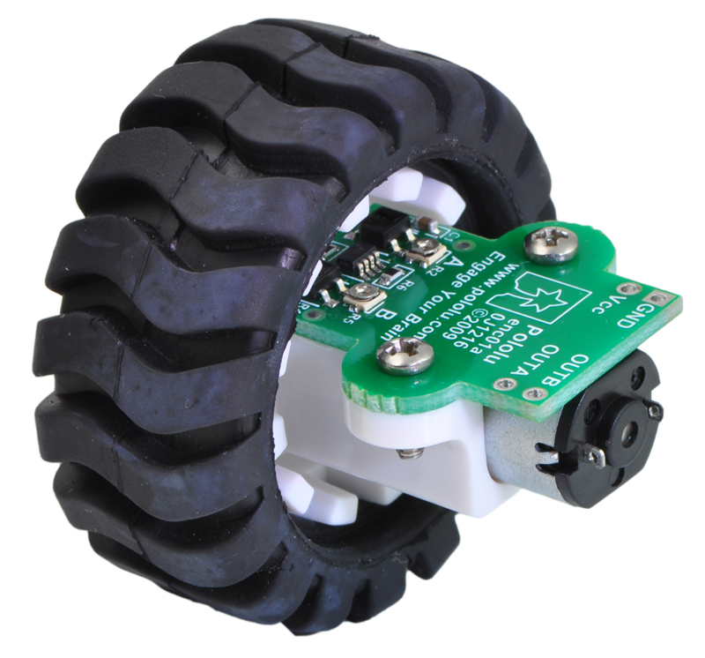
2) Wheel Encoders

Slide 17
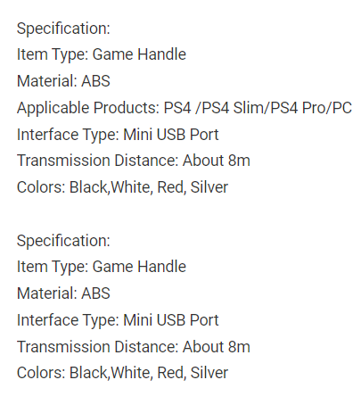
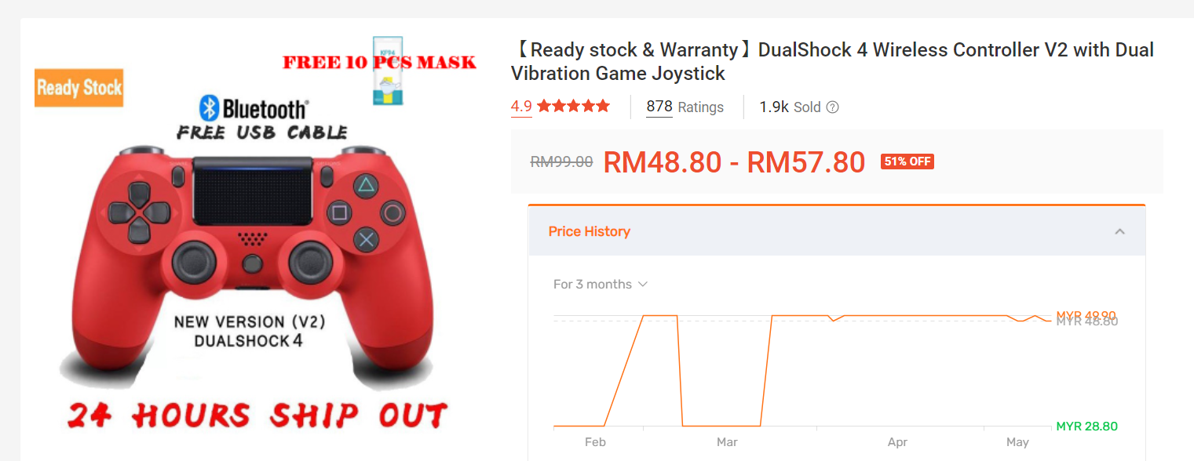
3) Wireless Joystick Controller

Slide 18
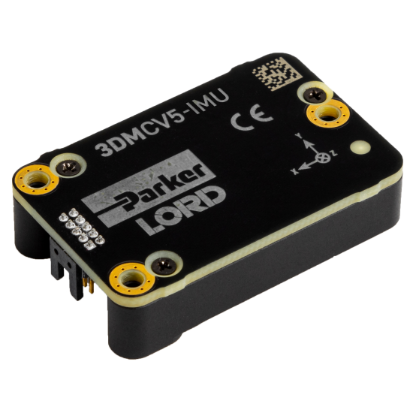
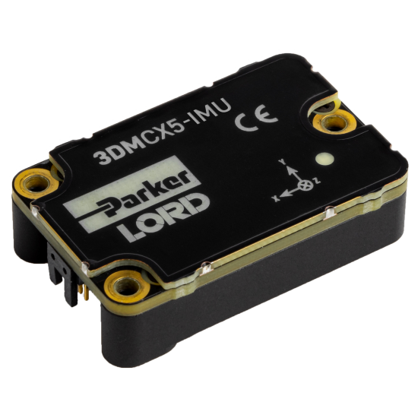
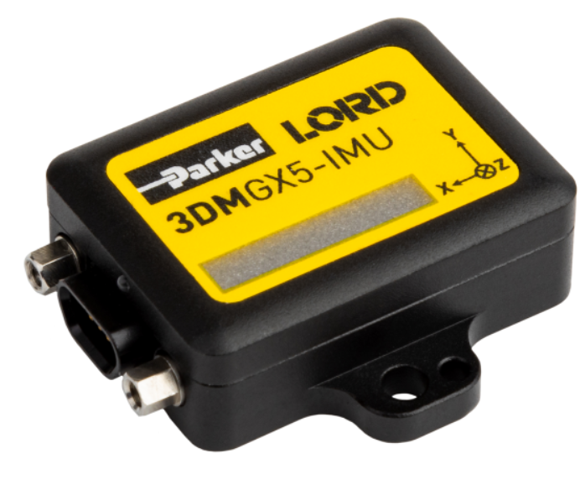
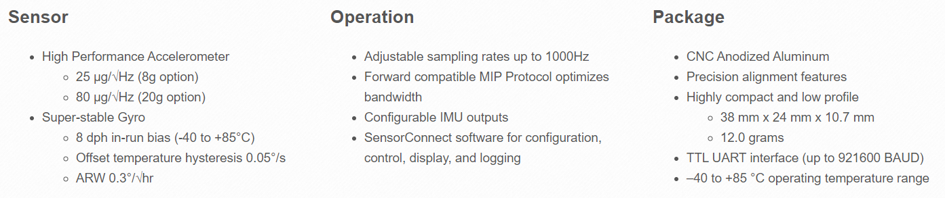
4) Inertial Measurement Unit (IMU)

Slide 19
DATA COLLECTION

Slide 20
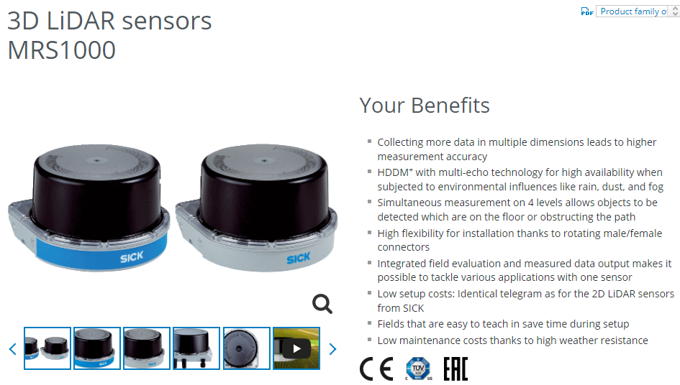
1) Lidar Sensor

Slide 21
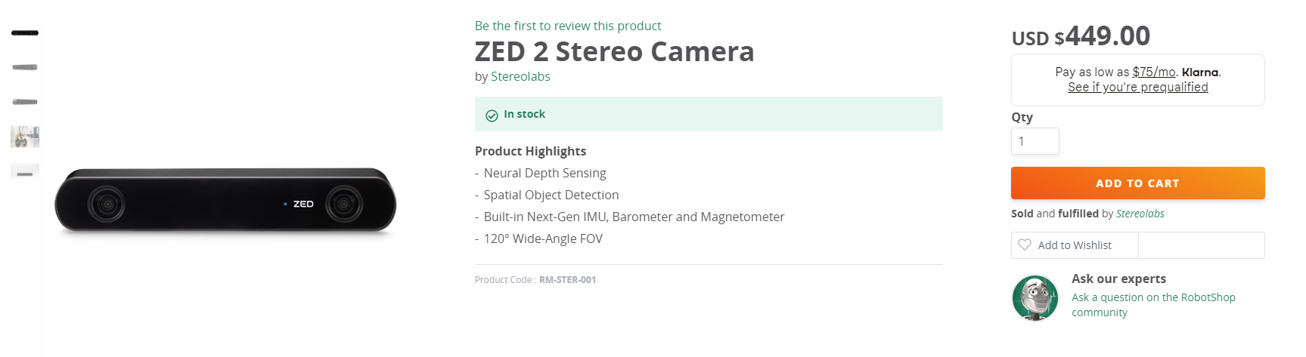
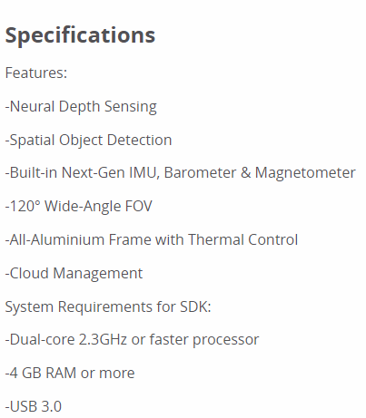
2) Stereo Camera

Slide 22
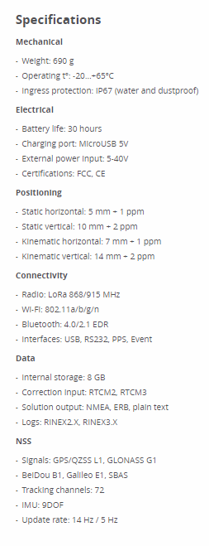
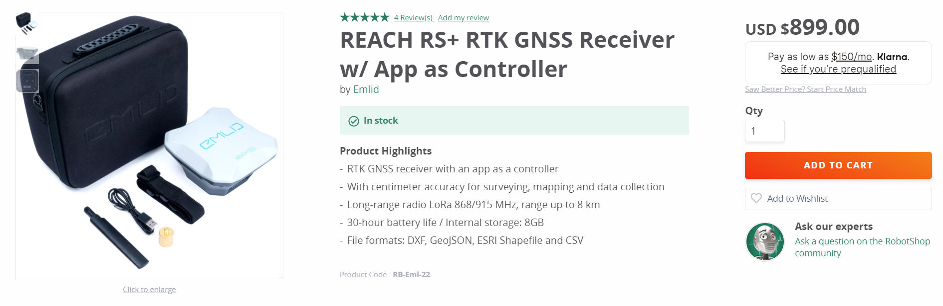
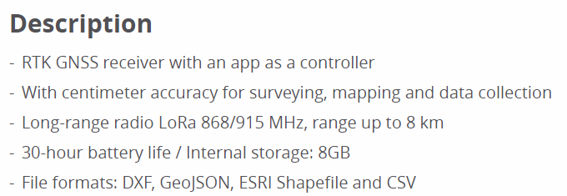
3) GPS

Slide 23
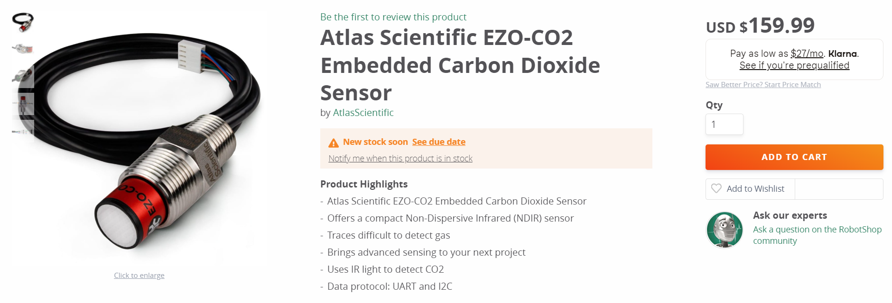
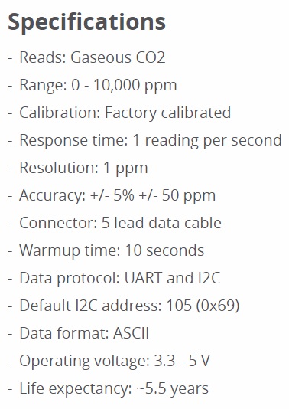
4) CO₂ Sensor

Slide 24
DATA TRANSMISSION

Slide 25
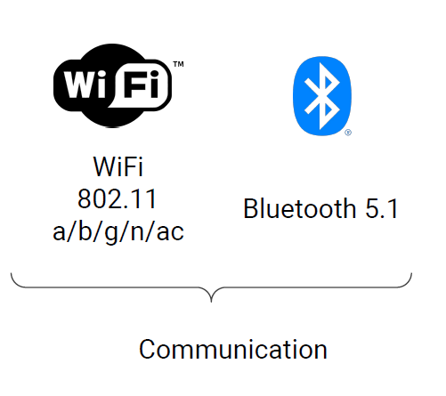
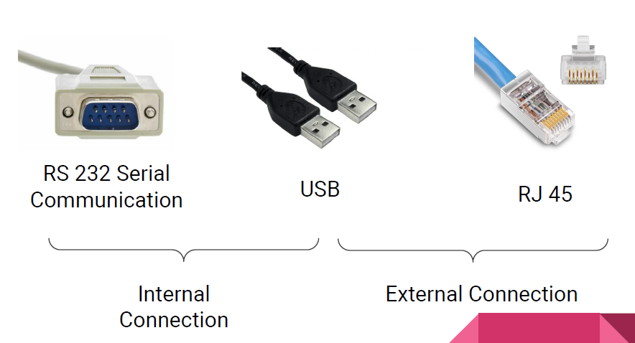

Slide 26
POWER SYSTEM MANAGEMENT

Slide 27
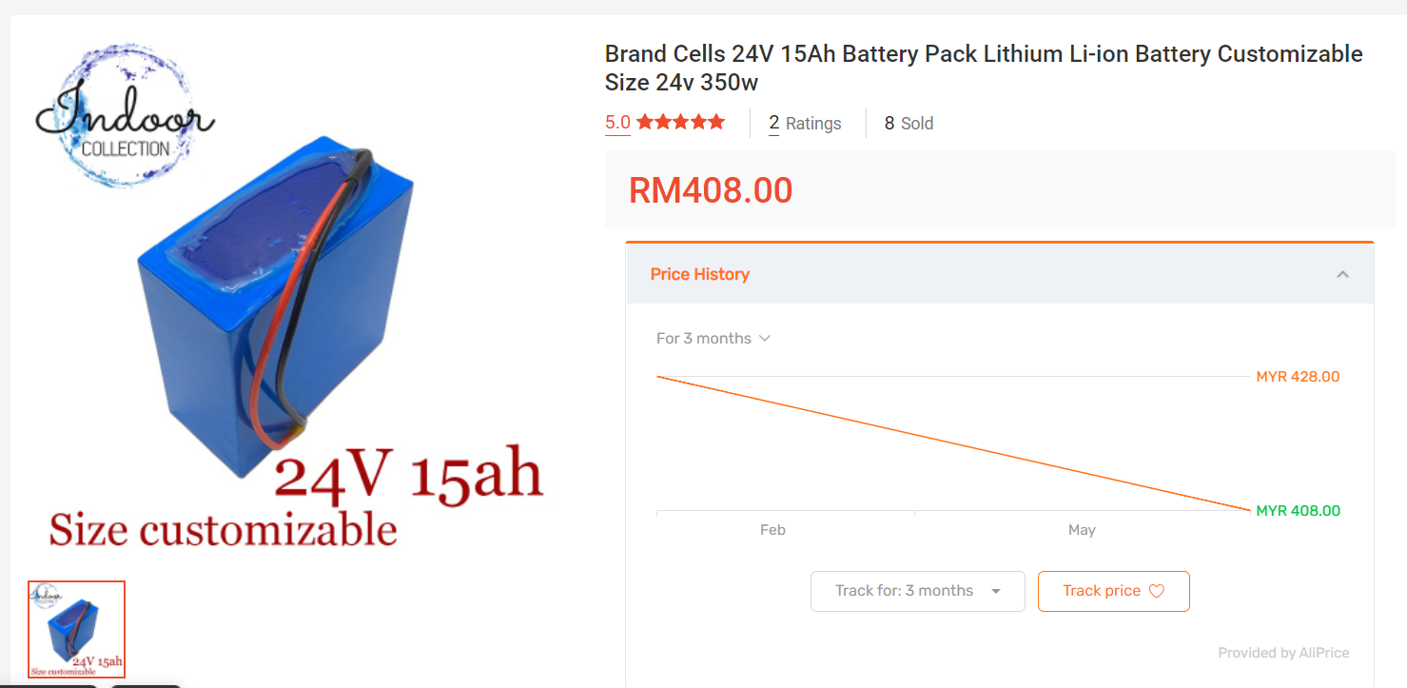
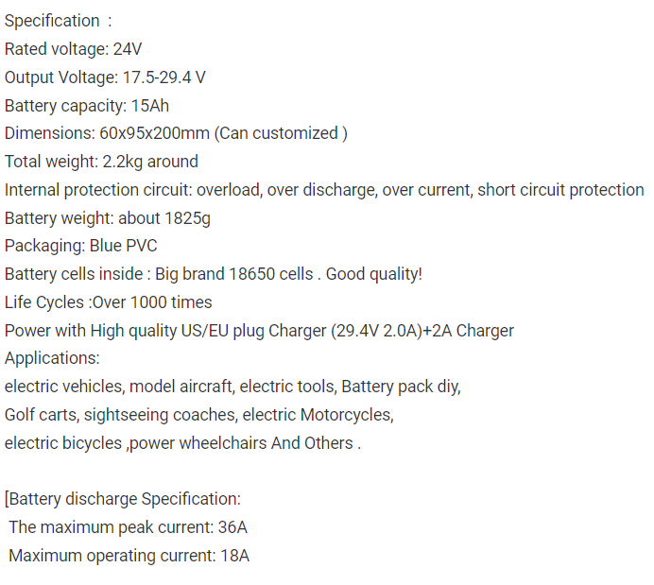
Li-ion Battery

Slide 28
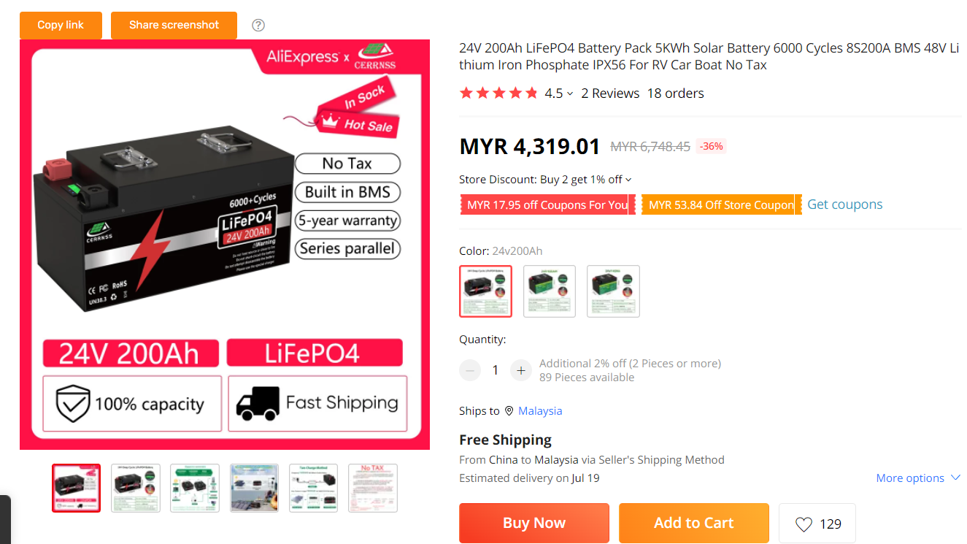
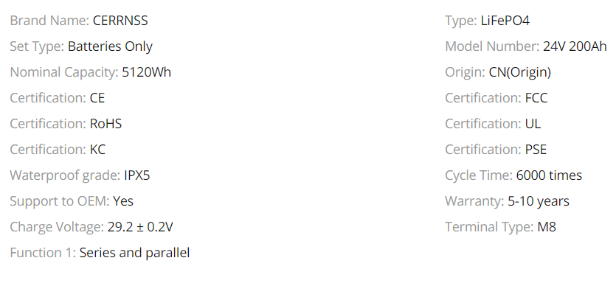
2) LiFePO4

